Slide 1
SOCIALISATION
Objectives:
  Understand the importance of socialization both for individuals and society
  Explain the nature versus nurture debate
  Learn the roles of families and peer groups in socialization
  Understand how we are socialized through formal institutions like schools, workplaces, and the government
  Explain how socialization occurs and recurs throughout life

Slide 2
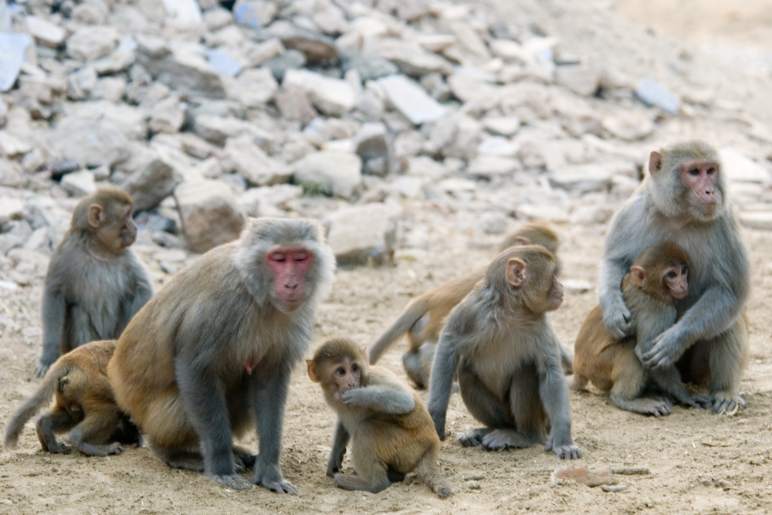
Intro: Socialisation
We depend on social interaction to provide the information and skills that we need to be part of society or even to develop a “self.”

Slide 3
Socialization: Definition
It describes the ways that people come to understand societal norms and expectations, to accept society’s beliefs, and to be aware of societal values.
The process by which an individual develops into functioning member of the group according to its standards, conforming to its modes, observing its traditions and adjusting himself to the social situations (Gillin & Gillin, 1968).

Slide 4
Socialisation as a Process
Conceptualized in three ways:
It is a process of learning (formal and informal both).
It is a process of personality formation and the development of self.
It is a process of internalization of social norms (expectations), values, moral codes and ideals of society.

Slide 5
Aims of Socialisation
Inculcates basic disciplines ranging from toilet habits to the methods of science.
Develops skills and capacities needed to fit into the society.
Teaches social roles (responsibilities) and their supporting attitudes.
Instills aspirations and satisfies needs of the individual.
Helps the transmission of culture from generation to generation.
Develops a sense of identity and the capacity of independent thought and actions.
Develops conscience.

Slide 6
Forms (Types) of Socialisation
Primary socialization. The family is an important agency.
Secondary socialization occurs during the last years. The school is an important agency.
Informal socialization: Takes place as a part of everyday activity.
Formal socialization: Acquisition of specific skills such as reading and writing.

Slide 7
Theories of Socialization
Sigmund Freud's Stages of Psychosexual Development
Charles Horton Cooley’s Theory of Looking Glass Self.

Slide 8
Psychological Perspectives on Self Development
Psychoanalyst Sigmund Freud (1856–1939) was one of the most influential modern scientists to put forth a theory about how people develop a sense of self.

Slide 9
Freud’s Theory of Psychoanalysis
Key to Freud’s approach to child development is to trace the formations of desire and pleasure in the child’s life.
The child is seen to be at the centre of a tricky negotiation between internal, instinctual drives for gratification (the pleasure principle) and external, social demands to repress those drives in order to conform to the rules and regulations of civilization (the reality principle).

Slide 10
Freud’s Theory of Psychoanalysis
Divided the self (human mind) into three parts:
id
ego
superego.

Slide 11
Psychoanalysis Cont.
Id: Instinctive desire, unsocialized, natural. Obscure, inaccessible personality. Source of drives (animal impulse of man –hunger, aggression and libido) demanding immediate satisfaction. These impulses are controlled and partially repressed into the unconscious, while a reality-oriented conscious self or ego appears.
Ego: Acting individual. Mediator between desires and action. Socialized self.
Superego (the conscience): Represents the social ideals (norms, values, traditions, and the idea of moral and immoral).

Slide 12
Theory of Psychosexual Development
The core of human personality is developed in phases of five namely; oapl&g.
At each stage, the child derives pleasure from a part of the body called erogenous zone.
Over-indulgence in pleasure or frustration leads to fixation
Fixation: Unresolved conflict, psychic energy remained attached.
Call for moderation to prevent fixation.

Slide 13
Oral Stage (from birth to age 1)
Pleasure from the mouth. Sucking and swallowing.
Too much sucking or swallowing - oral receptive person .
Oral receptive person: Overeating, gum chewing, alcoholism, smoking and kissing in adulthood.
Frustration - oral aggressive person.
Oral aggressive person: Argumentative, cynical and exploitative of others.

Slide 14
Anal stage (1-3 years)
Attention shifts to the process of elimination.
The child responds to toilet training with approval or disapproval.
Expresses approval or disapproval by letting go or holding up.
Letting go - anal expulsive, holding up - anal retentive.
Anal expulsive person: Messy, disorderly, destructive, cruel but generous.
Anal retentive person: Neat, orderly but obstinate and stingy.

Slide 15
Phallic stage (3-6 years)
The genitals become the source of pleasure. Increased sexual interest in the unconscious mind.
Attraction to the parent of the opposite sex with aggression for attention.
Freud calls this attraction Oedipus complex for males and Electra complex for females.
Adult traits of the phallic personality are sensitive pride, abnormal and excessive self-admiration and exhibitionism.

Slide 16
Latency (6 years to puberty)
Attention is on the acquisition of skills.
Sexual feelings subside. Development of self-confidence as one acquires skills
Internalization of sex specific social rules and behaviour. Status and role relationship.
Same sex friendship becomes strong.

Slide 17
Genital stage (11 years and above)
Begins from puberty through adolescence.
Ends with heterosexual love and attainment of full adult sexuality.
Masturbation is frequent. The focus is on moving towards sexual and emotional attainments outside the family.
The sexual energies are all reactivated. There is growing capacity for mature and responsible social and sexual relationships.
All unresolved conflicts of earlier stages are now activated and this resurgence is the reason why adolescence is such a trying period of human personality development.

Slide 18
Sociological Theories of Self Development
Sociologists conceive of development as both biological and social. Without interaction, humans do not develop from stage to stage.
Prove: Study of feral children.
Man’s biological nature, however, makes socialization both POSSIBLE and NECESSARY.

Slide 19
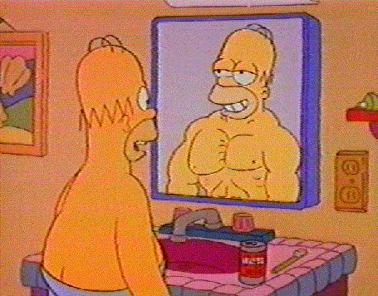
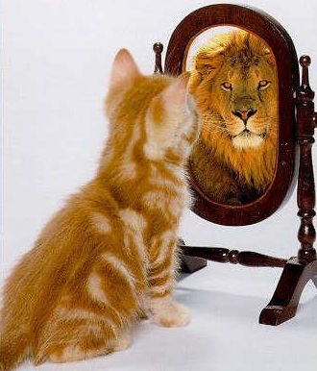
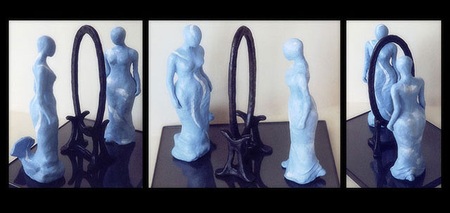

Charles Horton Cooley
(1864-1929)

Slide 20
C.H. COOLEY (1864–1929): Looking-Glass Self
How does a person arrive at a notion of the kind of person he is?
Looking glass self simply means how we see ourselves through the eyes of other people.
According to Cooley, there are three steps (stages) in the process of formation of looking-glass self

Slide 21
Steps/assumptions/statements/stages
The imagination of our appearance to others. How we imagine we look like to others.
The imagination of their judgment of our appearance. How we imagine others’ judge our behaviour or looks.
How we feel about their judgment i.e. our feelings (self- feeling) about their judgment
We often respond to these imagined evaluations with some feelings: pride, embarrassment, humiliation, pity, humility, ...

Slide 22
Important Concepts (Socialisation)
Anticipatory socialisation:
A person rehearses for future positions, occupation and social relationship. E.g. ?
Re-socialisation:
Socialisation to a new role or position in life which requires a dramatic shift in attitudes, values, behaviours and expectation learned in the past.
Re-socialization occurs throughout the human life cycle. Occupation, marriage and retirement, etc.

Slide 23
Important Concepts Cont.
Resocialisation is most dramatic in institutions like the armed forces, prisons, convents and mental hospitals.
Goffman (1961) has termed this situation as mortification of self.
Reverse Socialisation:
People being socialized are at the same time socializing their socialisers. Young people may affect the way parents dress, eat and even think. Students may modify the way lecturers teach, set exams, apply university rules, dress, talk, etc.

Slide 24
Important Concepts Cont.
Significant others:
Any person or persons with a strong influence on an individual's self-concept. E.g. father, mother, nurse, teacher or generally people with whom we have some form of intimate or primary association on daily basis.
Generalized others:
This is the general notion that a person has of the common expectations of society and its structures. Any time that an actor tries to imagine what is expected of them, they are taking on the perspective of the generalized other.

Slide 25
Agencies of socialisation
Most influential occurs particular groups called agencies.
Family
School
Peer groups
Mass media.
Workplace
Religion

Slide 26
Socialization and Deviation
Every member of a society is frustrated by the clash of his biological drives (such as sex) with the taboos of his culture.
Even though most persons conform to the norms of society, others deviate. Why?
Socialization is too rigid
All socialisation makes conflicting demands and, therefore, produces some antagonism to socialising agents.
Defects in socialization process. E.g. personality disposition of mental incapacity, through interruption of social learning and through incoherence or contradictions in the social environment.

Slide 27
NEXT WEEK
Individual and Society

